Slide 1
Preference-Based Training
for Legal Bail Prediction
Aryan Sawant U23AI042
Jaya Bhati U23AI043
Kuruv Patel U23AI051

Slide 2
The Core Architecture & Theory
TASK: Bail prediction; classifying whether bail is Granted or Denied (binary), or Ternary Classification based on case facts and legal arguments from Indian courts.
LegalDelta is a reinforcement learning framework designed to improve an LLM's legal reasoning capabilities.
Instead of just teaching the model to output the correct final answer, it trains the model to generate meaningful Chain-of-Thought (CoT) reasoning
If the reasoning genuinely helps the model arrive at the answer, the information gain is high, and the model receives a higher reward during RL training.

Slide 3
DPO on il_tur dataset
DPO on nyayaumara dataset
GRPO on il_tur dataset (Future Work)
APPROACHES

Slide 4
https://www.overleaf.com/1422428328nrxrxjrwswdv#19f666
DPO: Direct Preference Optimization
An algorithm for Reinforcement Learning from Human Feedback (RLHF).
Instead of training a separate "Reward Model" to judge the LLM, DPO uses a dataset of pairs: a Preferred response and a Rejected response.
It forces the model to increase the probability of the preferred answer while decreasing the probability of the rejected one.

Slide 5
GRPO: Group Relative Policy Optimization
It generates a group of multiple outputs for the same prompt and rewards the ones that perform best relative to the others.
It uses "Reward Functions" (code-based rules) to score outputs.
GRPO eliminates the need for a massive "Critic" model, saving huge amounts of VRAM, which is why it works so well with libraries like Unsloth.

Slide 6
DPO on il_tur dataset
Perfect accuracy and vanishing loss giving no gradient for backpropagation.
Objective: Use DPO to align the ‘zephyr-sft-bnb-4bit’ model with judicial decisions on the same IL-TUR bail dataset.
Chosen Response: Uses the actual judge's opinion or a correct generic response.
Rejected Response: Acts as the negative constraint by providing the opposite, incorrect legal outcome.
Model aggressively favoring the chosen response over the rejected one.

Slide 7
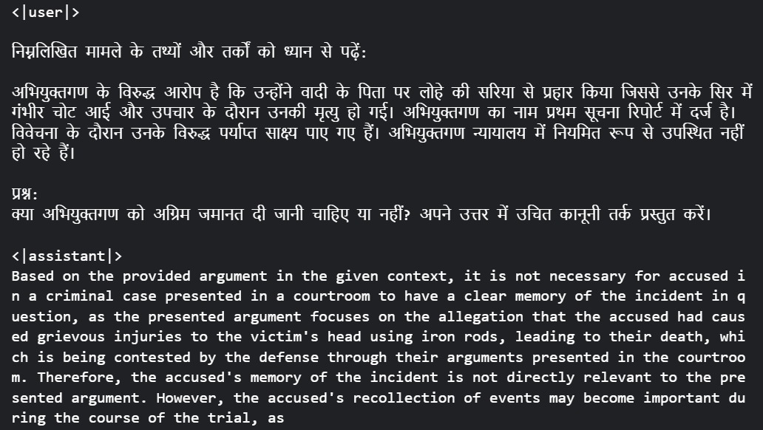

Slide 8
DPO on nyayaumara dataset
Validation Loss (0.1278) is actually lower than Training Loss (0.1345) -> zero overfitting
Objective: Use DPO to align the ‘Qwen2.5-3B-Instruct-bnb-4bit’ model with judicial decisions on the nyayaumara bail dataset.
Transform the raw classification dataset into (prompt, chosen, rejected) preference triples required for DPO
parameter-efficient fine-tuning: applied LoRA on Qwen2.5-3B-Instruct-bnb-4b. Merge the LoRA adapters into the base model.it
Accuracy and Rewards are slightly higher on the validation set, meaning the model is picking up patterns that translate perfectly to unseen data

Slide 9
Validation Loss decreased (learning stability) and improved accuracy.
Log probability gap between the correct legal answer and the wrong one is growing; the model is becoming more confident in its legal reasoning
The Logits/chosen and Logits/rejected are very close. This suggests the model isn't making "wild" guesses yet.

Slide 10
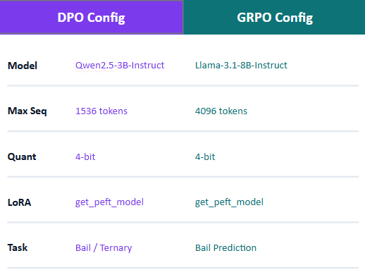
Setup
Nyanaumara dataset
Exploration-Lab/IL-TUR dataset

Slide 11
GRPO on il_tur dataset
Information Gain Multiplier: Calculates a diversity bonus based on logic differences (LegalDelta formula).
Objective: Fine-tune Meta-Llama-3.1-8B-Instruct to predict bail outcomes (Granted/Denied) from case facts using the Exploration-Lab/IL-TUR dataset.
XML Format Reward: Grants positive rewards for strictly adhering to the <reasoning> and <answer> XML tags.
Accuracy Score: Rewards accurate predictions (+2.0 for correct, -1.0 for hallucinations, 0.5 for format-matching errors).

Slide 12
Key modifications in GRPO:
Swaps the previous Qwen-based model for Llama 3.1 8B providing superior bilingual performance
Replaces English/Chinese system prompts with a native Hindi
System Prompt
Specialized reward functions (xmlcount and bail_accuracy) to enforce strict formatting and accurate legal outcomes

Slide 13
Thank you

